Slide 1
#2 Making fRiends with: ggplot2
library(dplyr)
rladies_global %>%
filter(city == ’Munich')

Slide 2

Hello!
I am Pam
And today I am very happy to share with you some tips on how to create fun plots using ggplot2

Slide 3
Smoothly
sliding into ggplot2
🎨
1. First steps
2. Base Graphics vs ggplot2
3. ggplot2 & Grammar of Graphics
4.
(or hands-on stuff)
Pro tip: Do stop and ask me at any time!

Slide 4
1.
First steps
Take a visit to the GitHub repo https://github.com/pamelamatias/RLadies_MUC
and either clone or download the files we’ll be using ☺

Slide 5
2.
Base Graphics vs ggplot2
or why should I try something new?

Slide 6

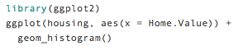
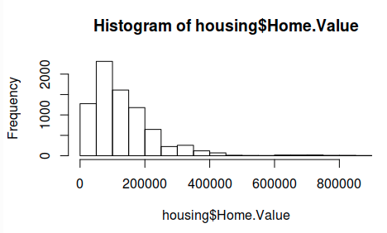
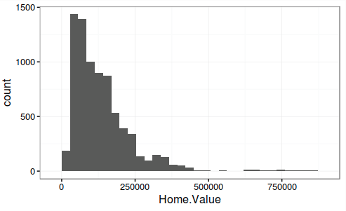
Base graphics
ggplot2
more verbose for simple plots ):
Images and code borrowed from a very nice Harvard tutorial

Slide 7
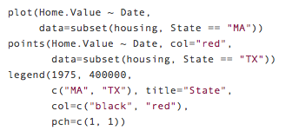
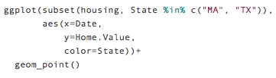
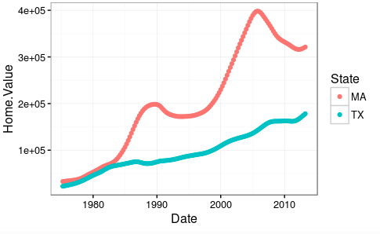
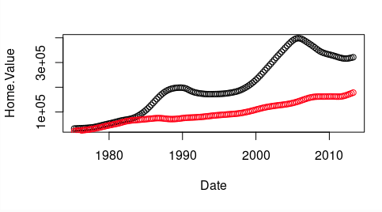
Base graphics
ggplot2
Less verbose for complex graphs!
Images and code borrowed from a very nice Harvard tutorial

Slide 8
3.
Grammar of Graphics & ggplot2
or “how to make sense out of all of those layers”

Slide 9
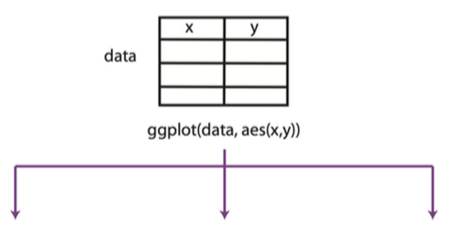
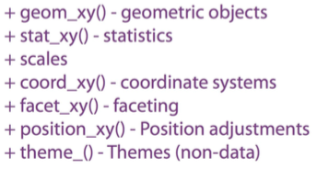
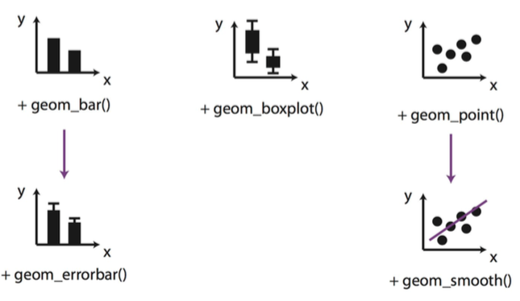
Grammar of graphics &
ggplot2
rladies_global %>%
diagram.source(city == ’Berlin')

Slide 10
The emphasis in ggplot2 is reducing the amount of thinking time by making it easier to go from the plot in your brain to the plot on the page”
—Hadley Wickham, 2012
(as cited in Christine Zhang’s “Storytelling with Data” Workshop at Boston University)

Slide 11
4.
🎨
(or hands-on stuff!)

Slide 12
Dataset
Inside Airbnb

Slide 13
Thanks!

Slide 14

Now let’s go for cookies & beer!
Not necessarily at the same time though…
Let’s say then
cookies | beer!
😋

